Slide 1

Welcome to
Zoom Family Worship
It would be helpful if you had the following available for this session:
Something which reminds you of farming
Something with which you can make furrows
Notes:
INSERT WHAT IS NEEDED FOR THE SESSION SO PEOPLE CAN COLLECT IT

Slide 2
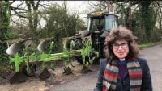
God speed the plough
God speed the plough
Blessed be God
Father, Son and Holy Spirit
Blessed be God for ever
Plough Blessing
Notes:
You can ask somebody to lead this part

Slide 3
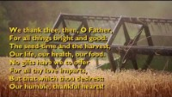
Worship
Notes:
Insert Song

Slide 4
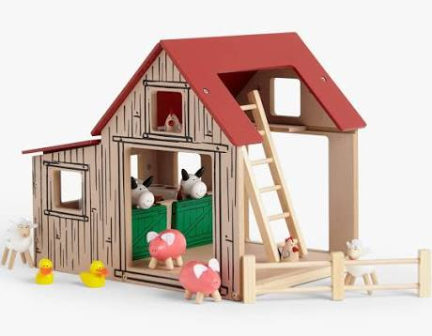
What helps you to remember farming in your prayers?
Notes:
Opening Activity or Question

Slide 5
Pray
Notes:
Opening Activity or Question

Slide 6
What is ploughing?
Notes:
You can ask somebody to lead this part

Slide 7
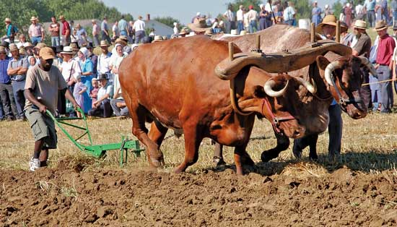
Word: Luke 9
Someone said, “I will follow you, Lord; but first let me go back and say goodbye to my family.”
Jesus replied, “No one who puts a hand to the plough and looks back is fit for service in the kingdom of God.”
Notes:
Bible Story/ Reading

Slide 8
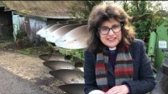
A Straight Furrow
Notes:
Bible Story/ Reading

Slide 9

Pray
Lord have mercy
Christ have mercy
Notes:
Use these responses in a time of repentence. Afterwards use the words (or others authorised for CofE)
“ May God forgive us by the death of his Son and strength us to live in the power of his Spirit”

Slide 10
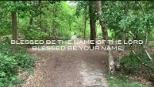
Sung Worship
Notes:
Insert Song

Slide 11
Lord’s Prayer
Our Father who art in heaven, hallowed be Thy name
Thy Kingdom Come,
Thy will be done on earth as it is in heaven
Give us this day our daily bread
And forgive us our trespasses as we forgive those who trespass against us
And lead us not into temptation but deliver us from evil.
For Thine is the Kingdom, the power and the glory
For ever and ever. Amen
Notes:
All but prayer leader muted initially Unmute selves to say Amen

Slide 12
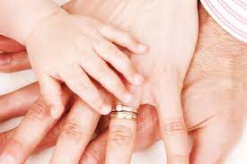
Blessing
Notes:
Say a prayer of blessing
All but leaders muted initially to allow for the event to conclude. Remain in gallery mode (no powerpoint so we can see each other).

